Slide 1
Thomas Hall
Eagle Scout Project Review

Slide 2
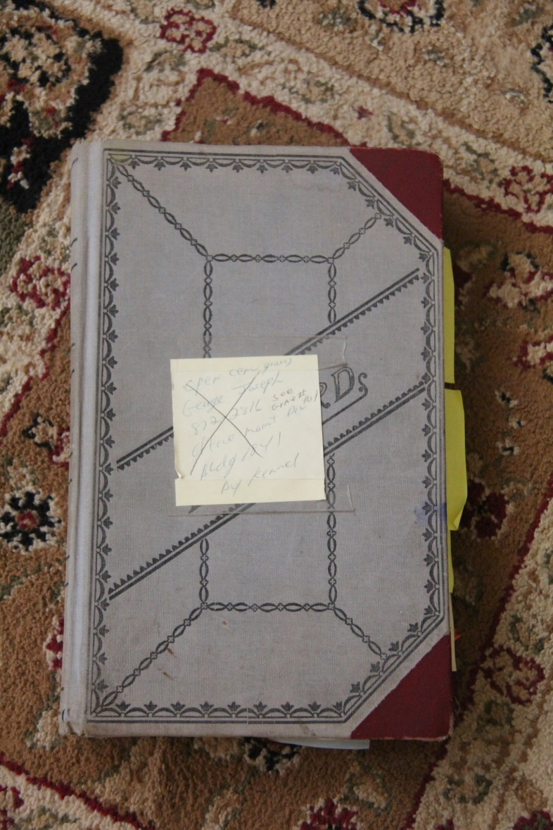
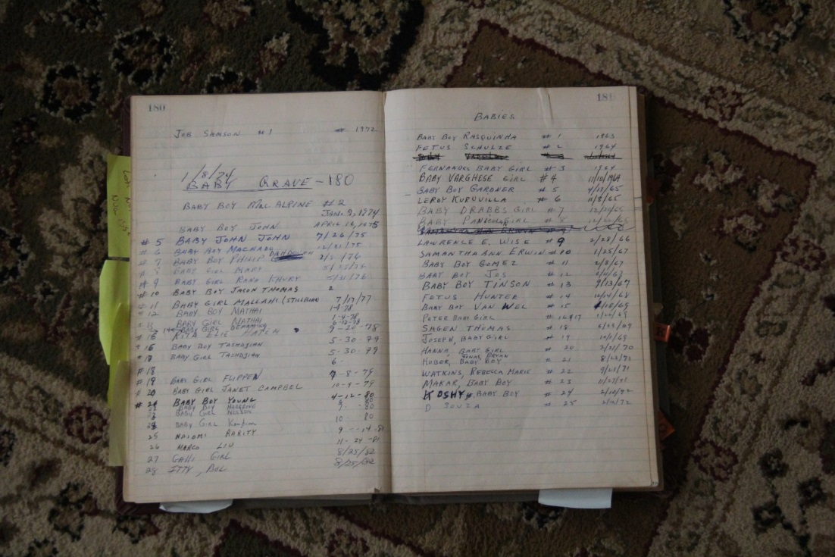
Existing Cemetery Record Book

Slide 3
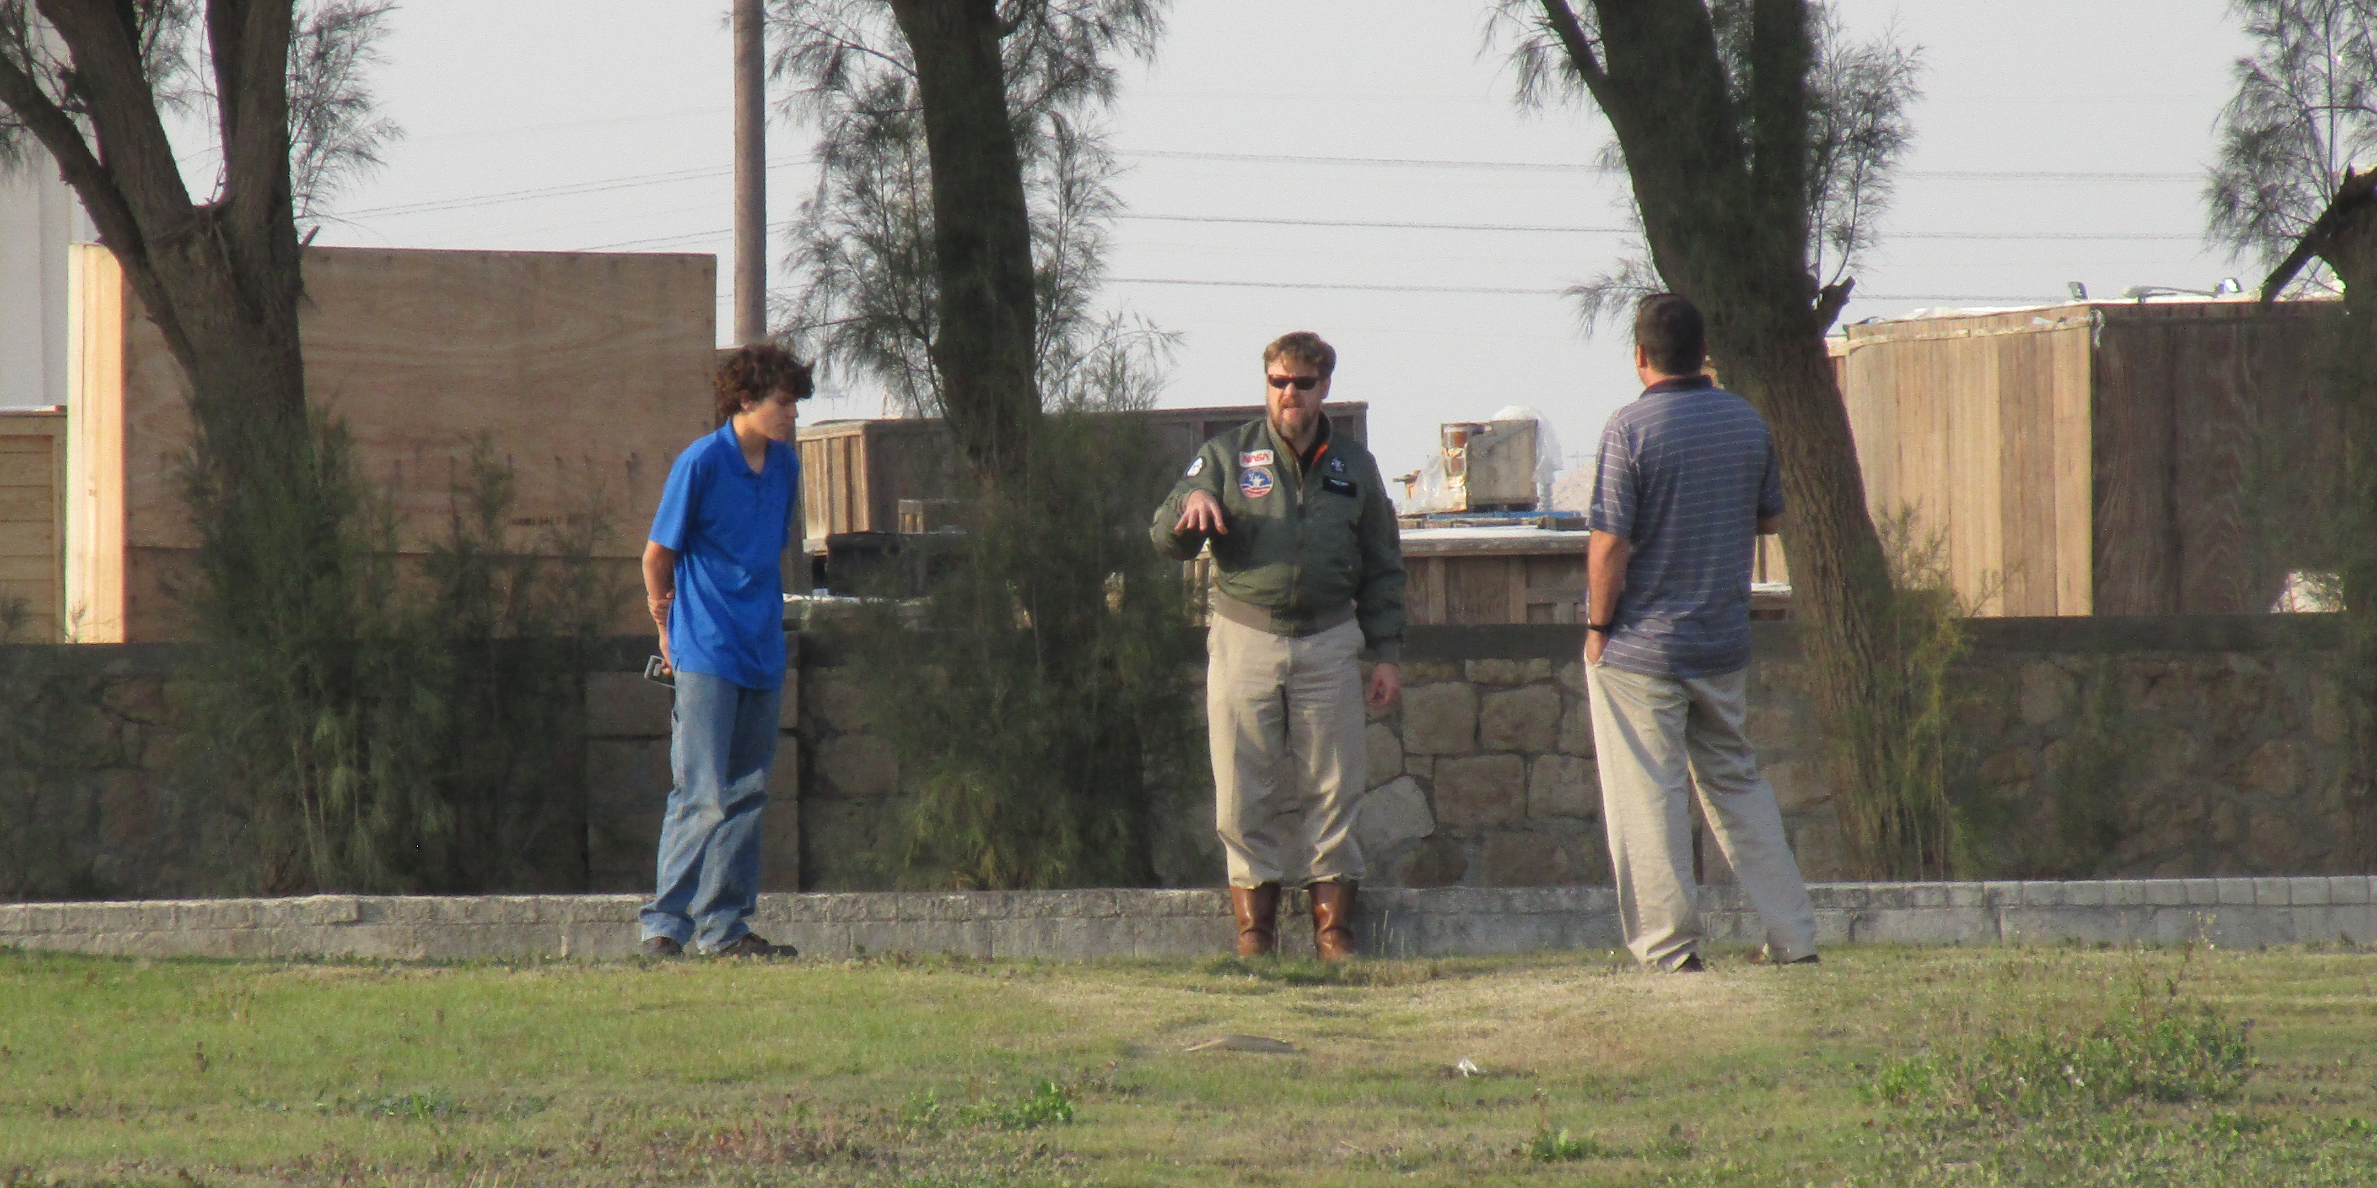
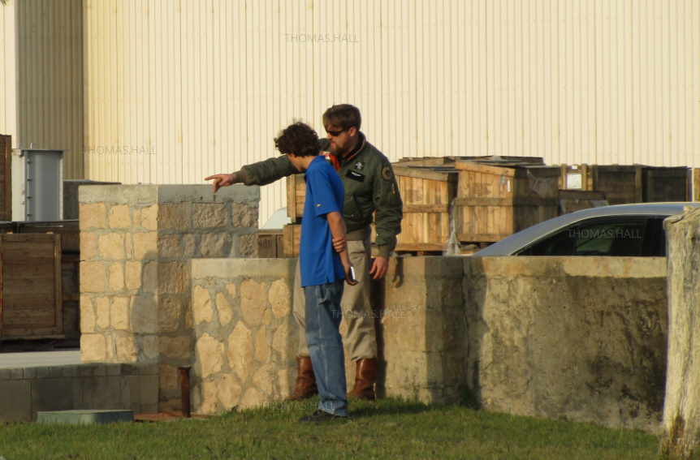
Planning Session with Surveyor

Slide 4
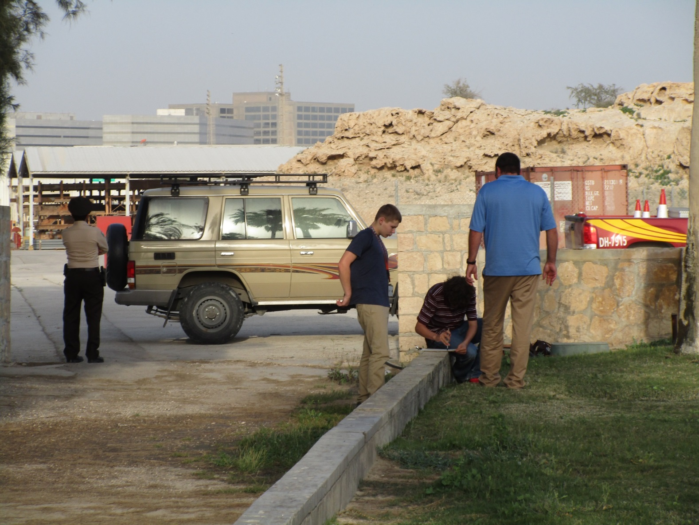
Site Survey – parental advice (with security chaperone)

Slide 5
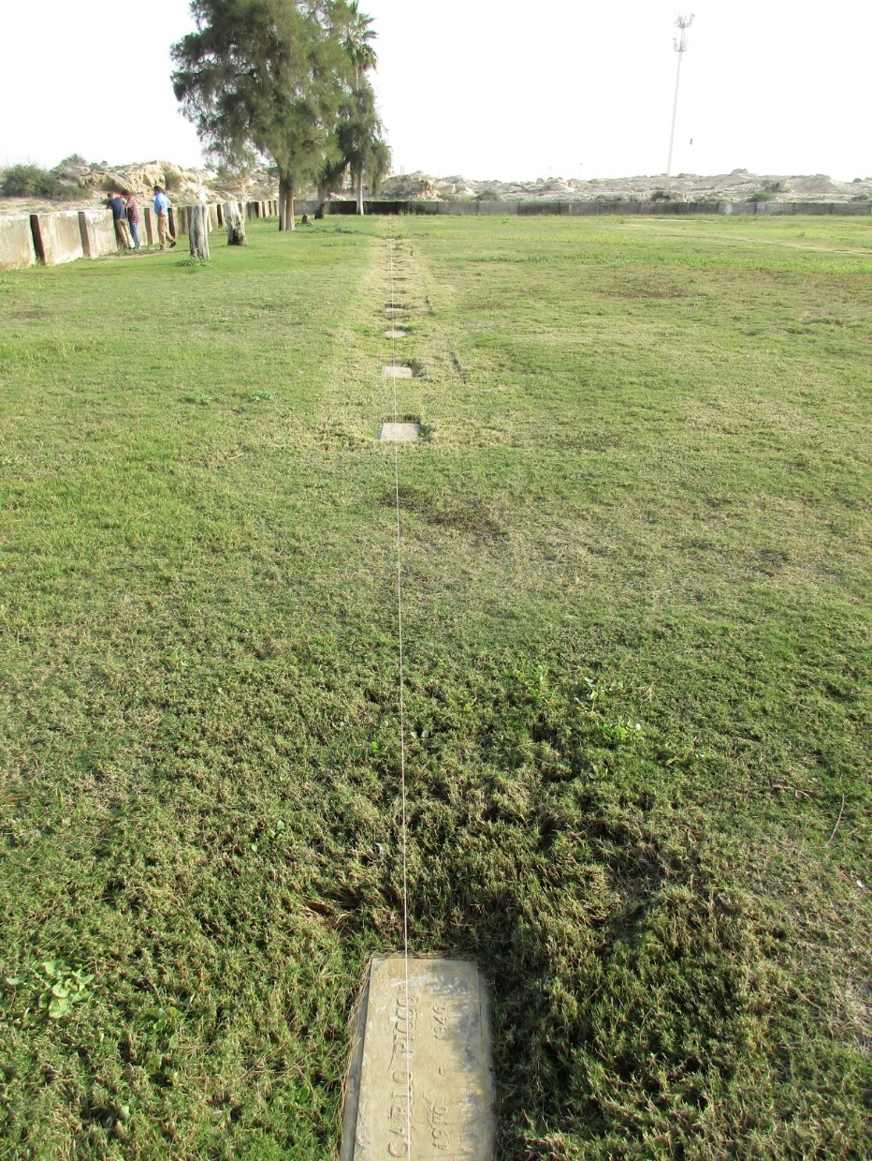
Site Survey – measurement line

Slide 6
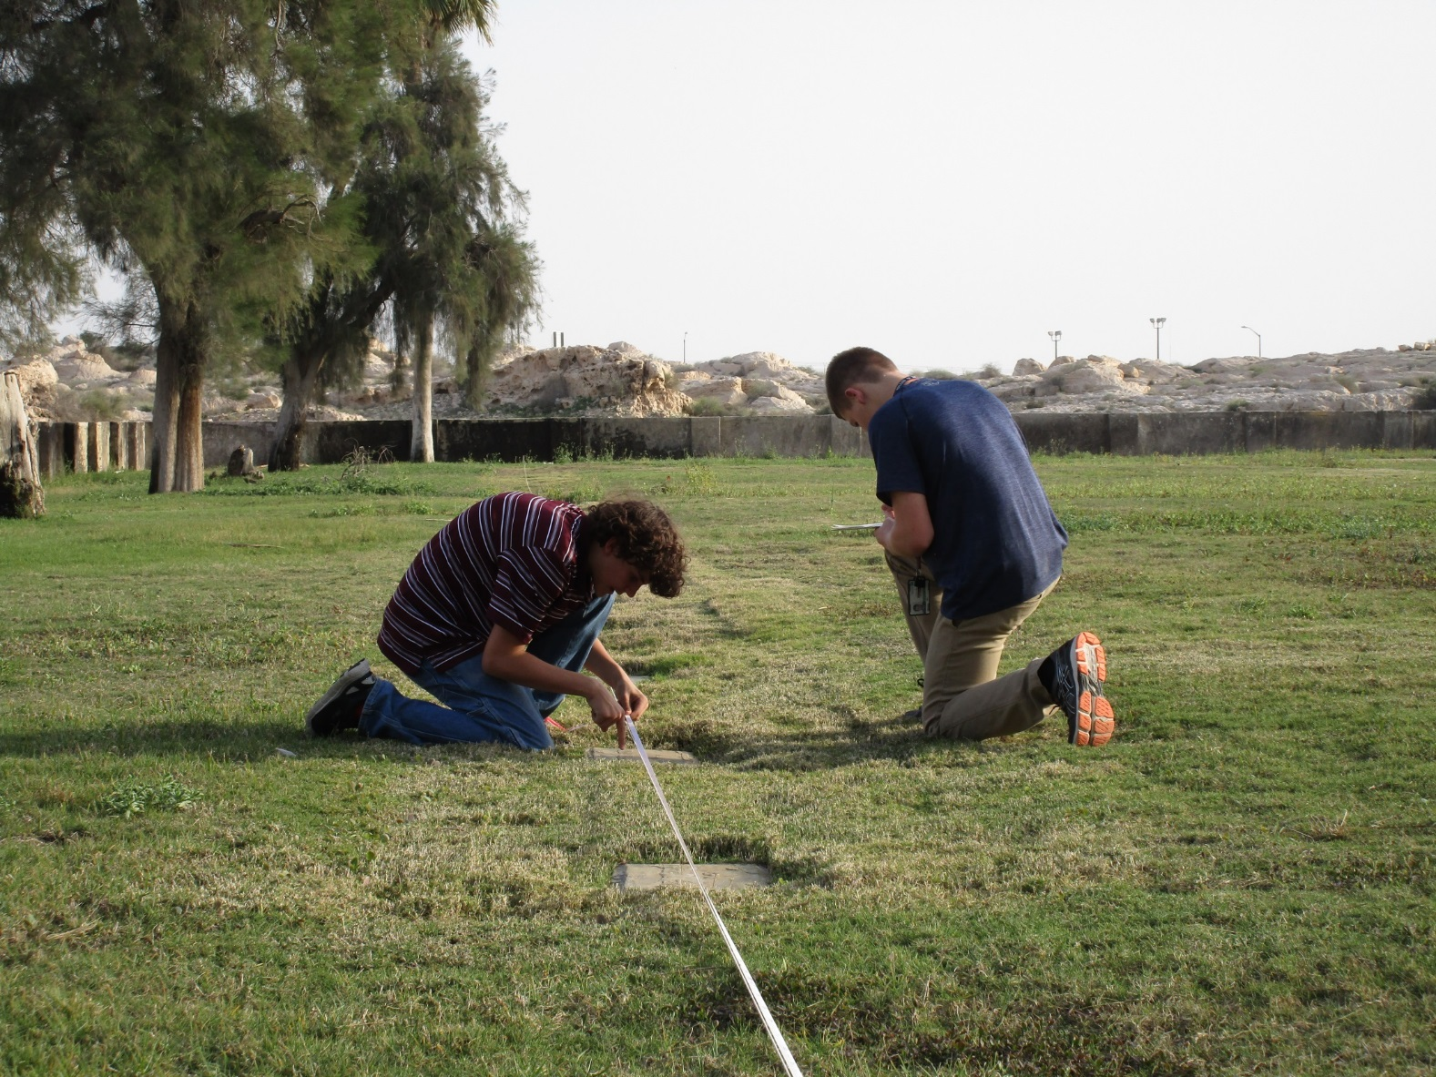
Site Survey – measuring grave markers

Slide 7
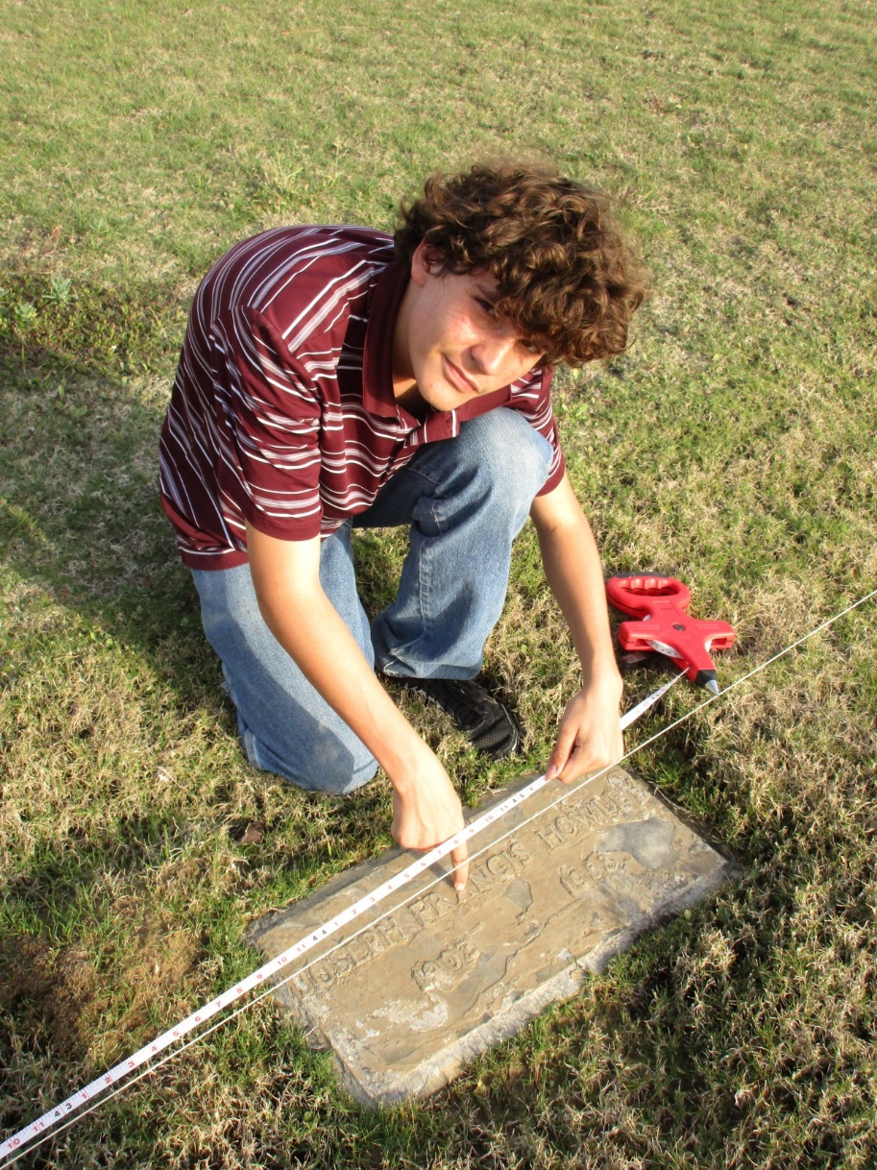
Site Survey – measuring grave markers

Slide 8
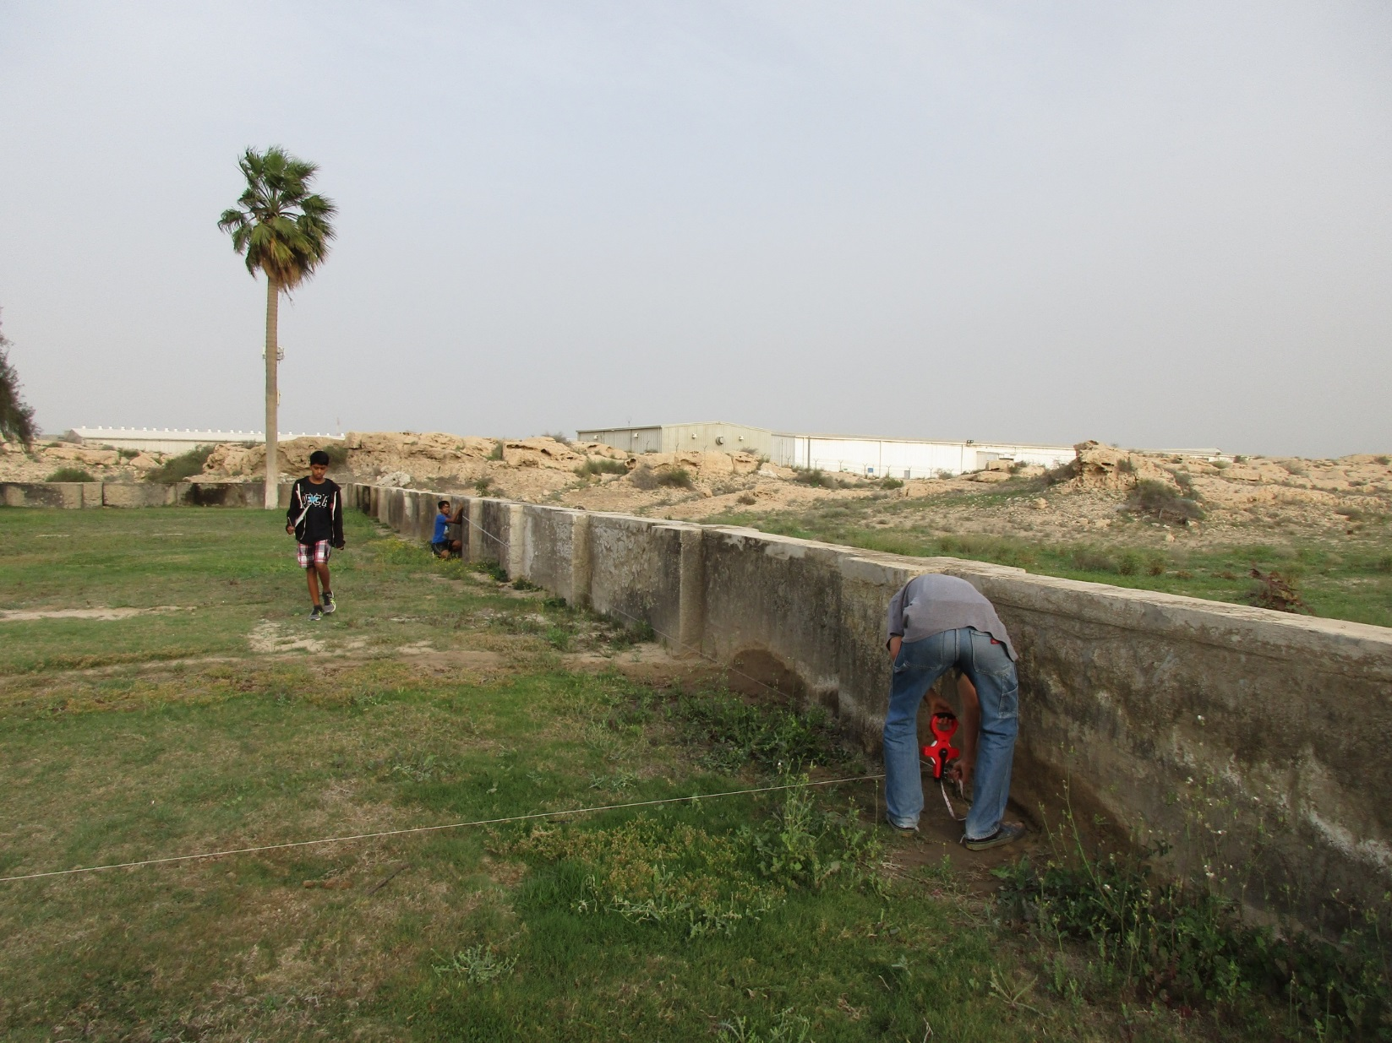
Site Survey – measuring offsets

Slide 9
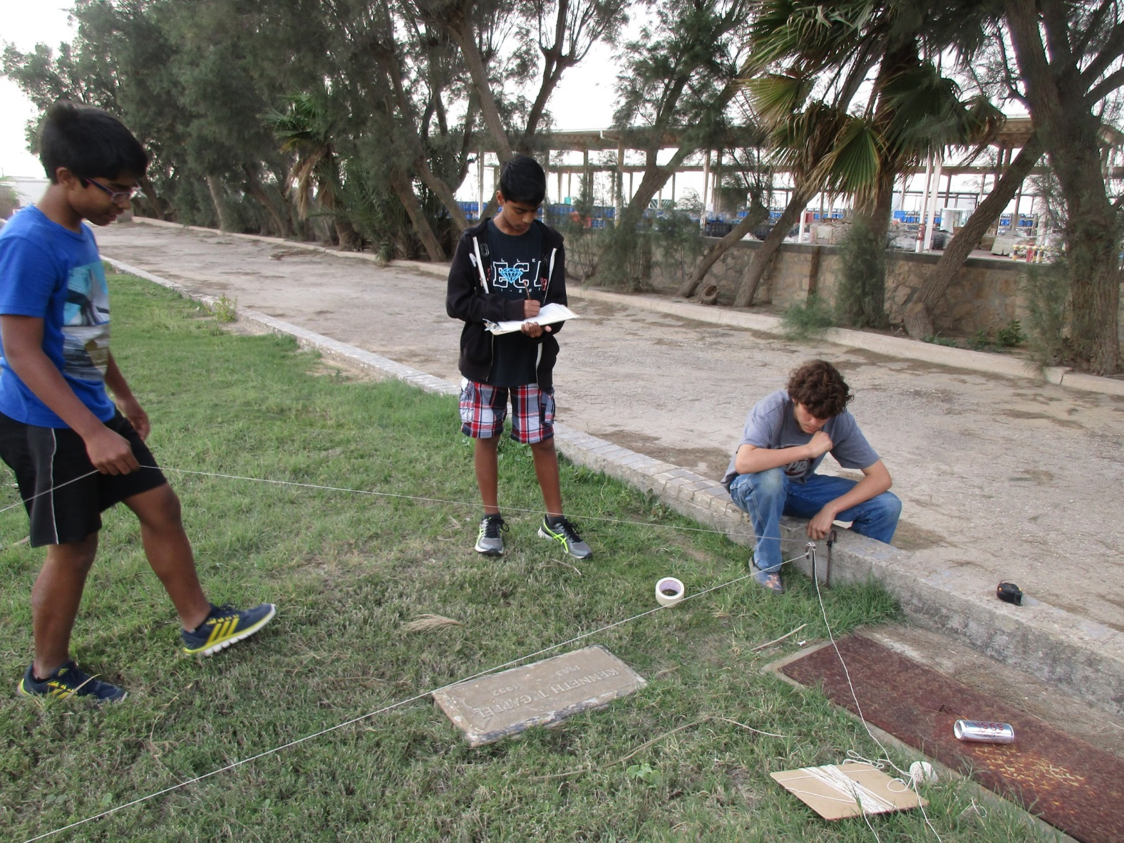
Site Survey – contemplation or confusion?

Slide 10
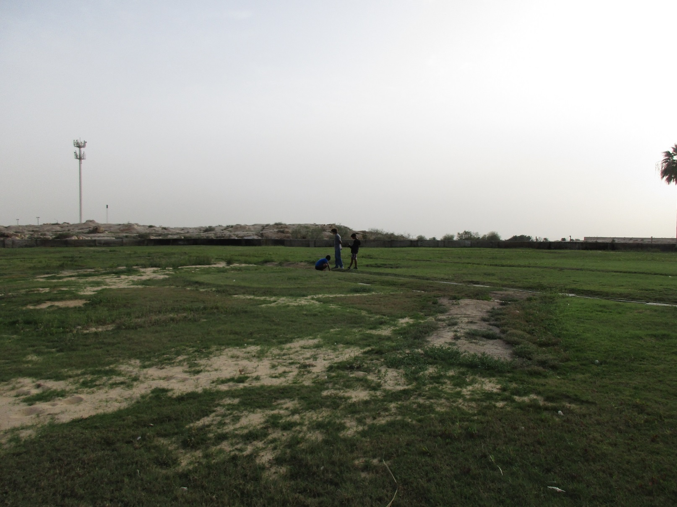
Site Survey – perspective on cemetery

Slide 11
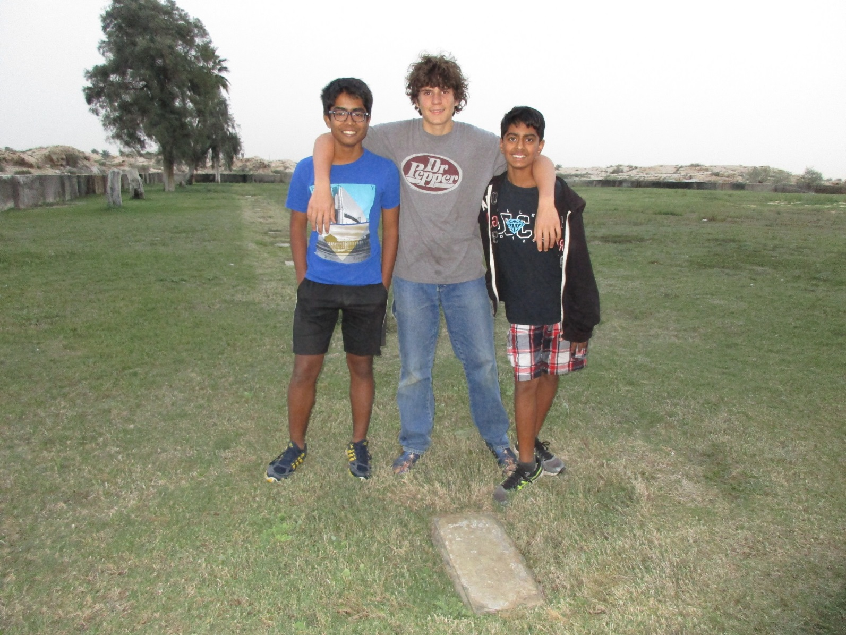
Site Survey – job well done

Slide 12
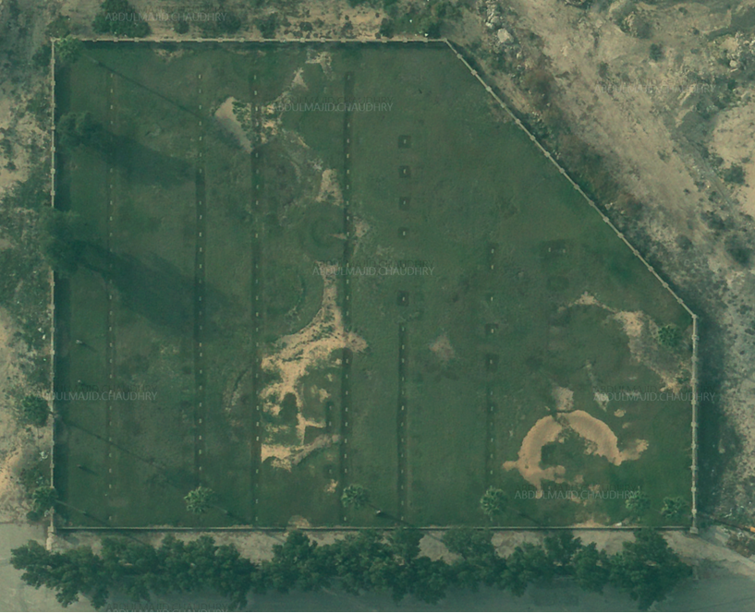
High Resolution Aerial Photo

Slide 13
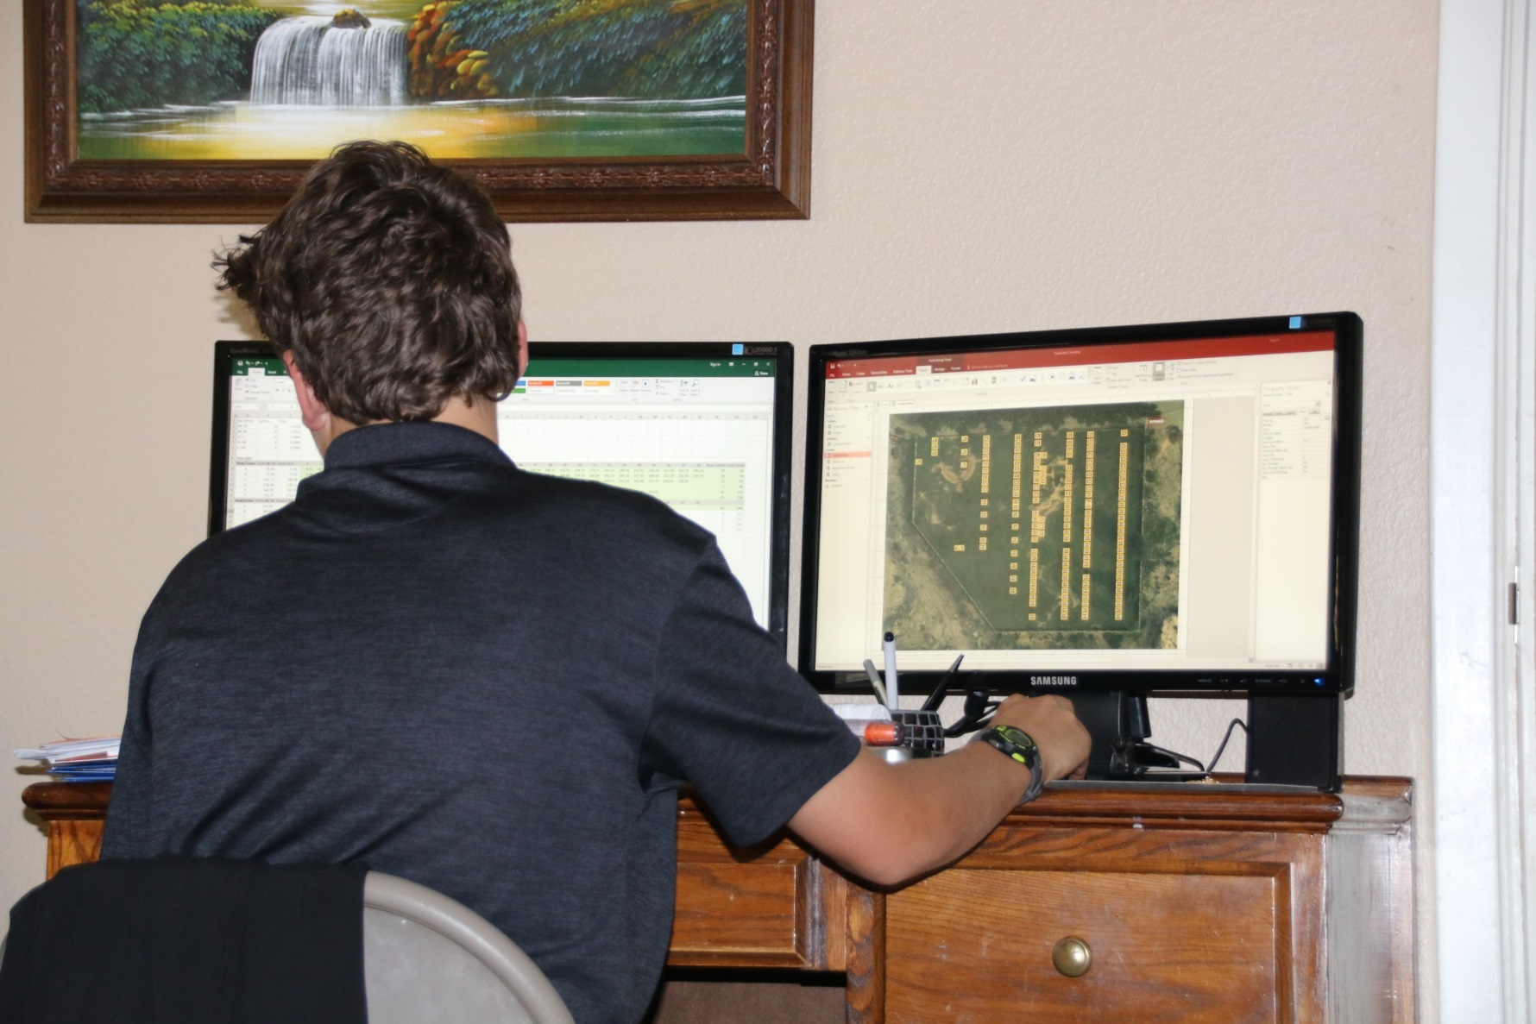
Database Creation

Slide 14
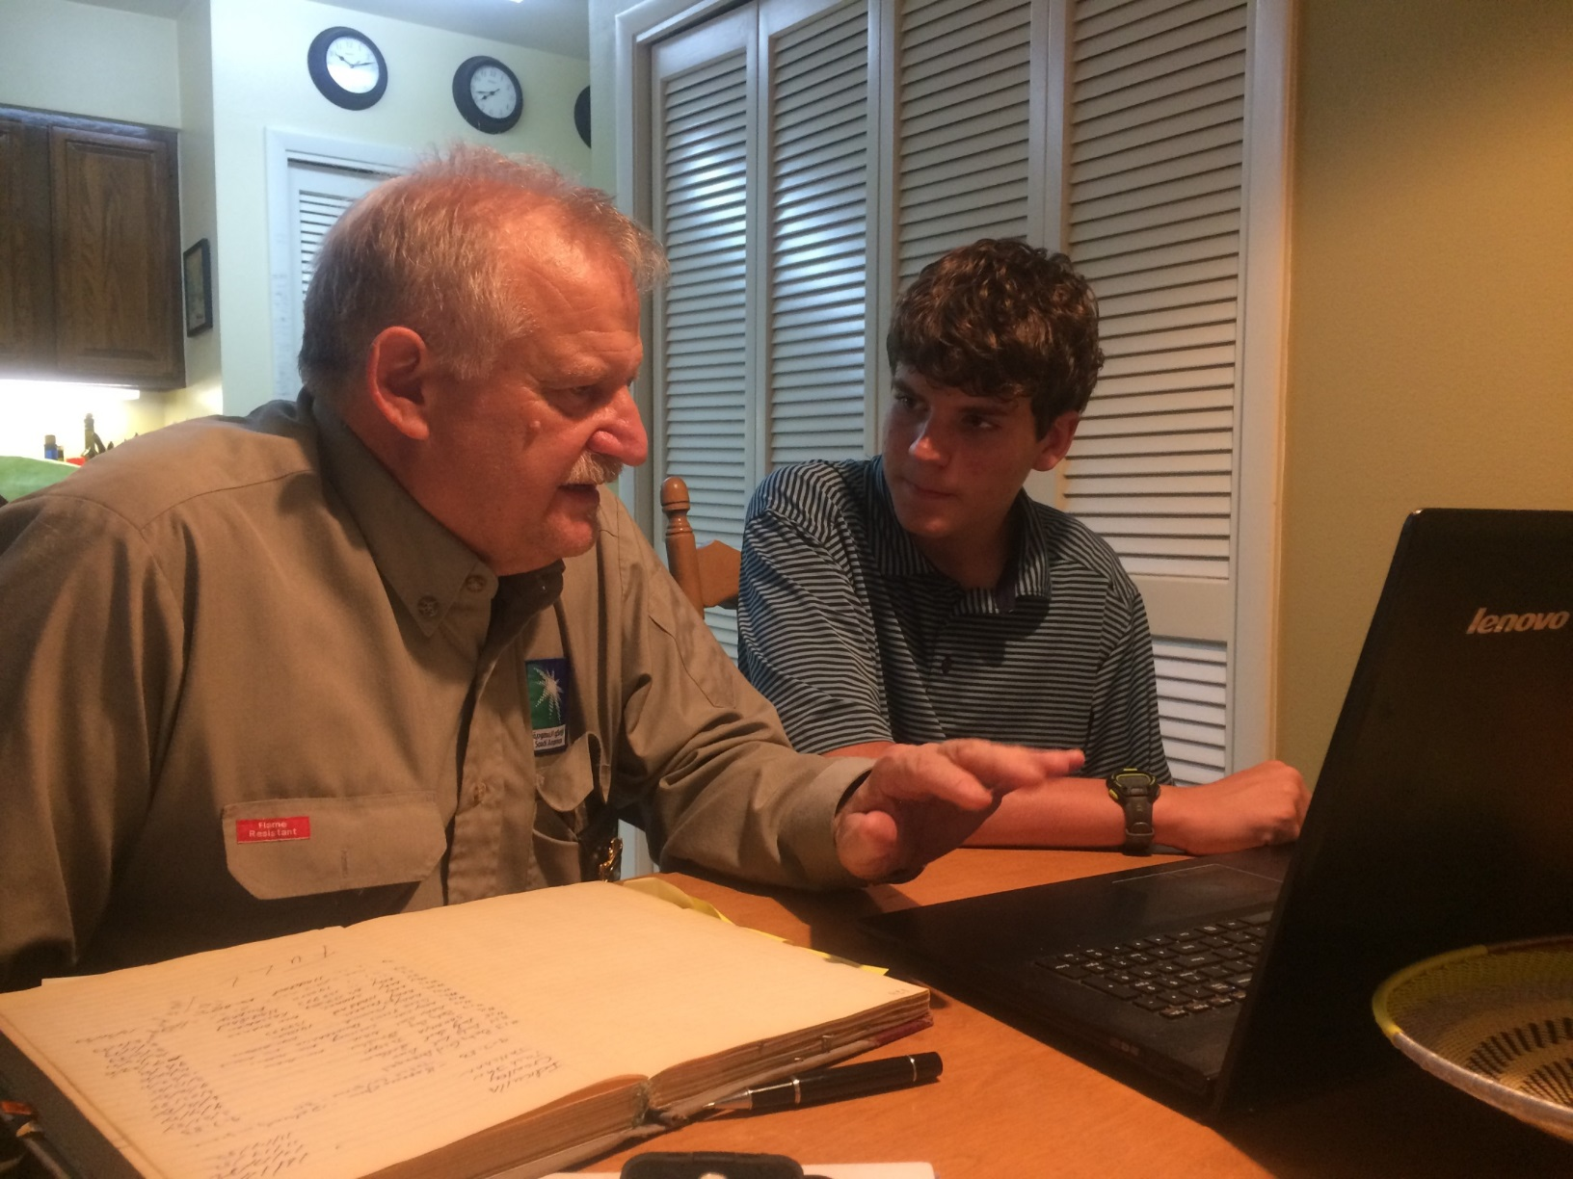
Scoutmaster Review

Slide 15
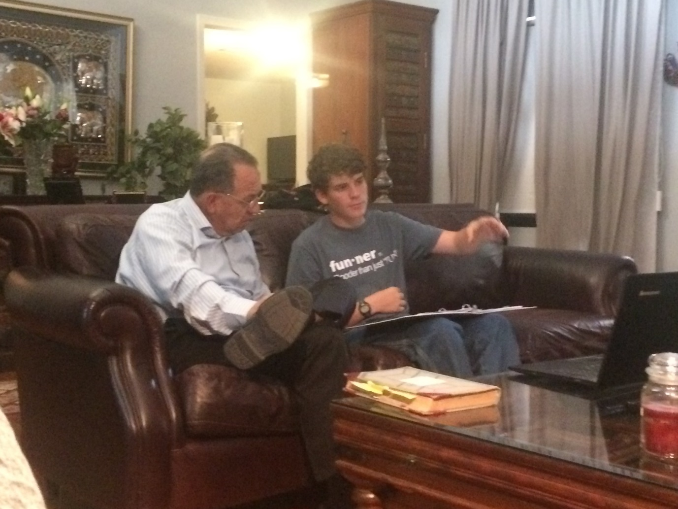
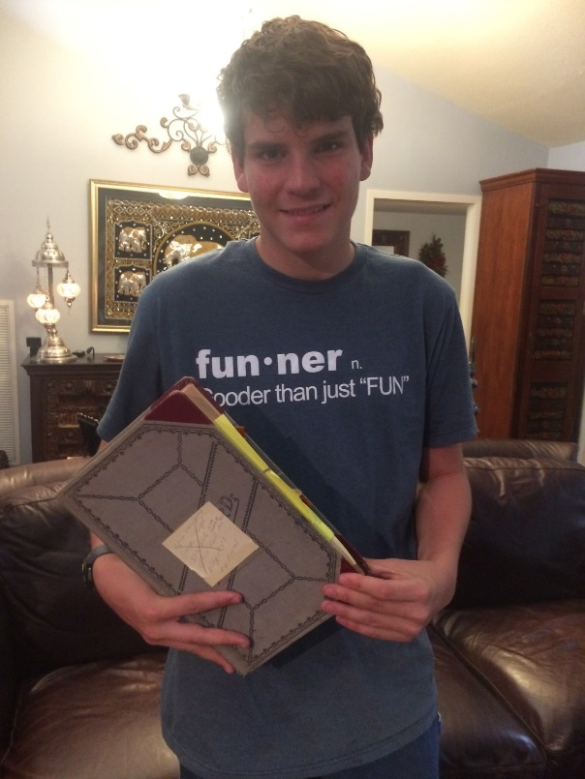
Review with Project Sponsor

Slide 16
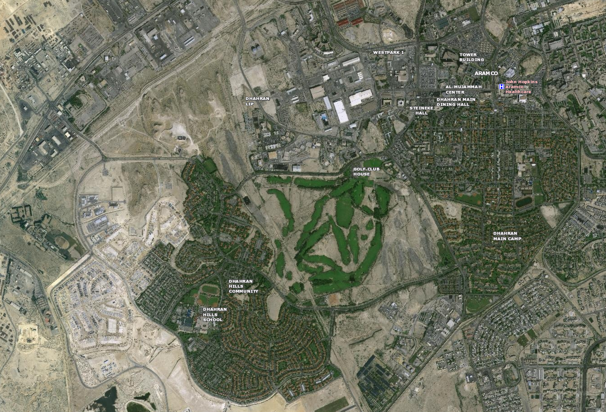
Difficulties – access to location
Graveyard location in LIP

Slide 17
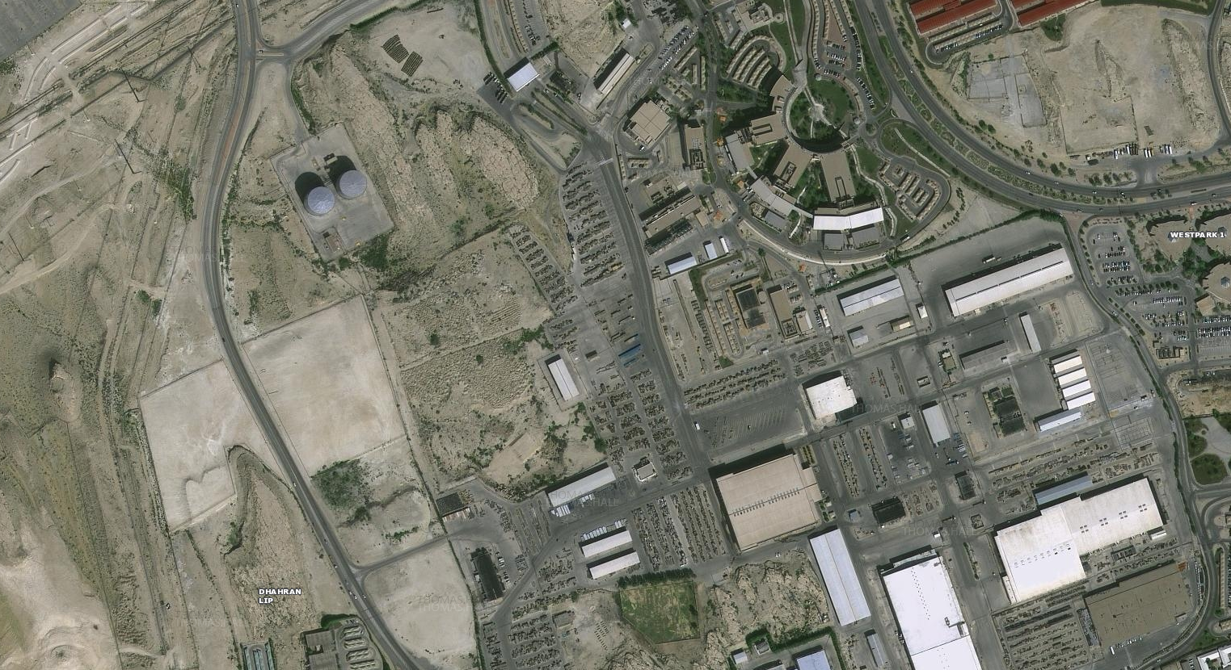
Difficulties – access to location
Restricted Access
Cemetery location in LIP

Slide 18
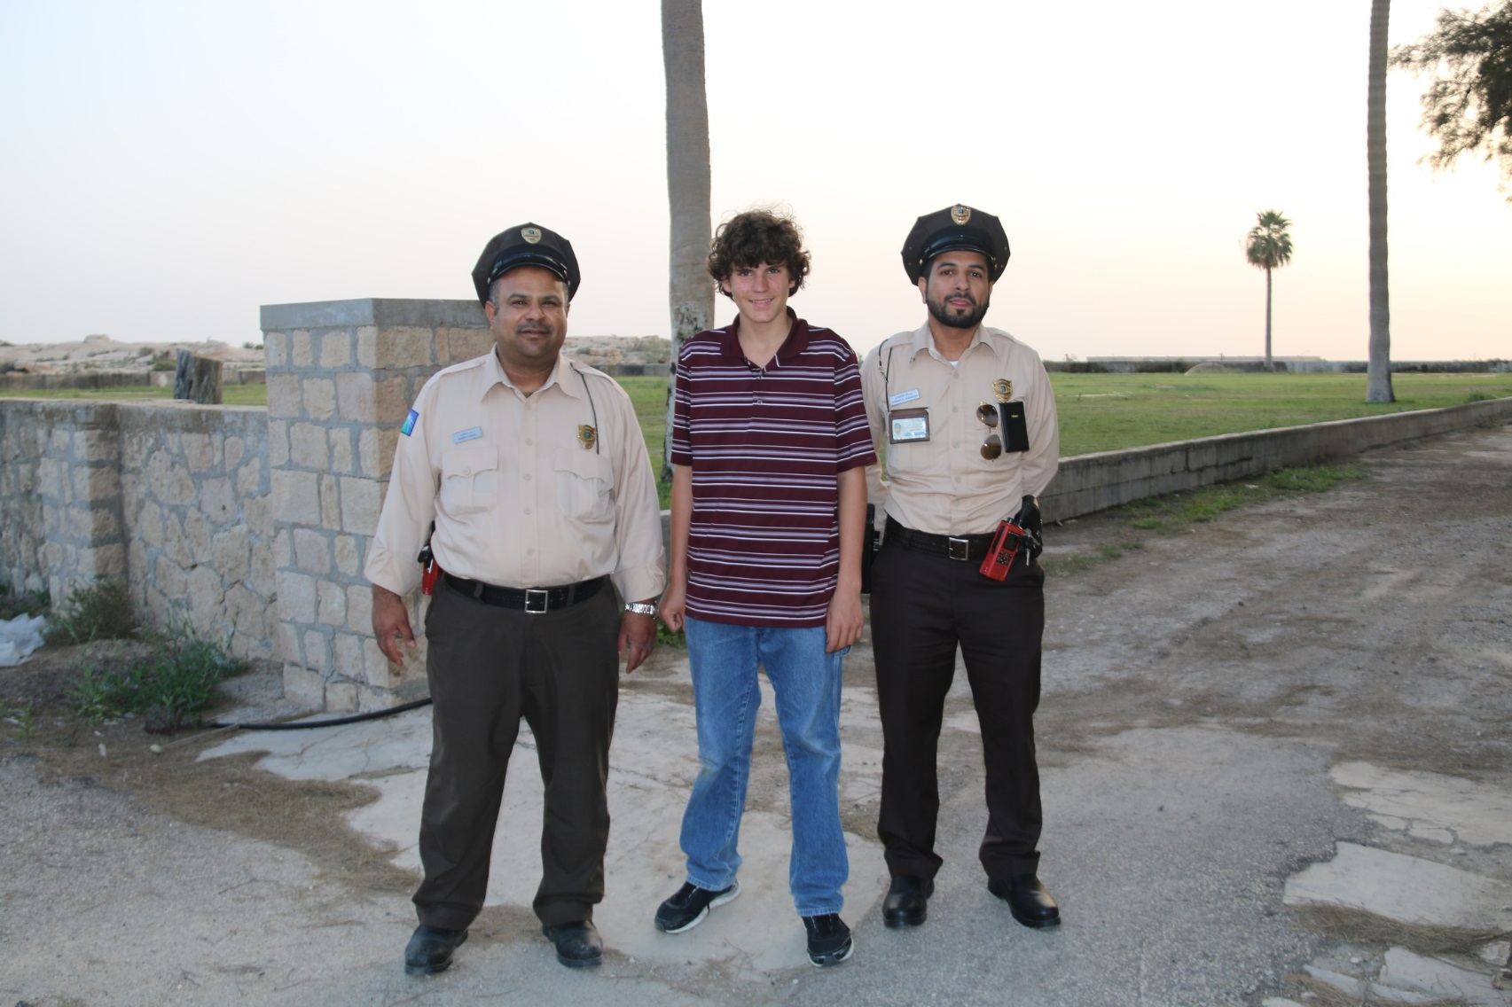
Security support on the project

Slide 19
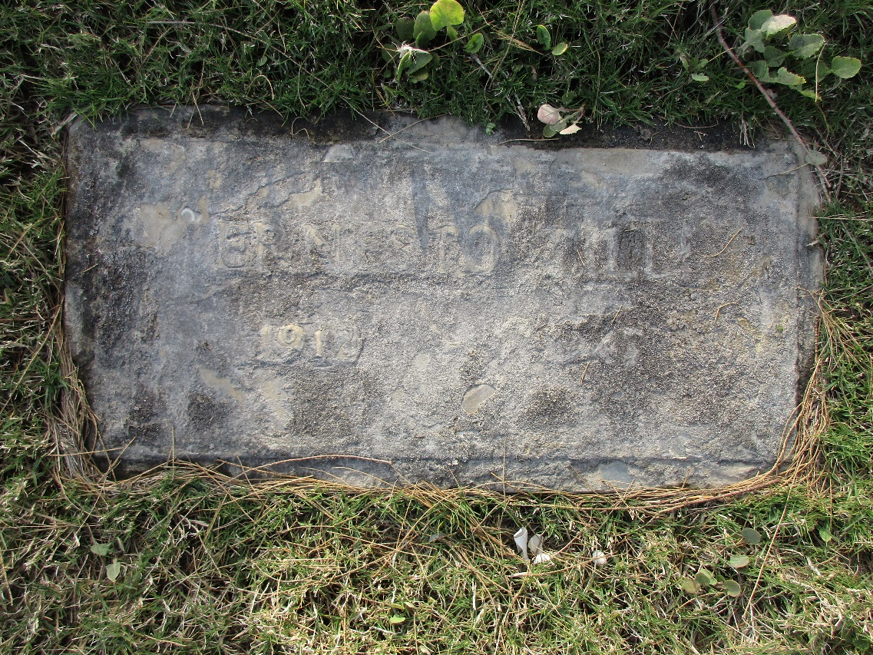
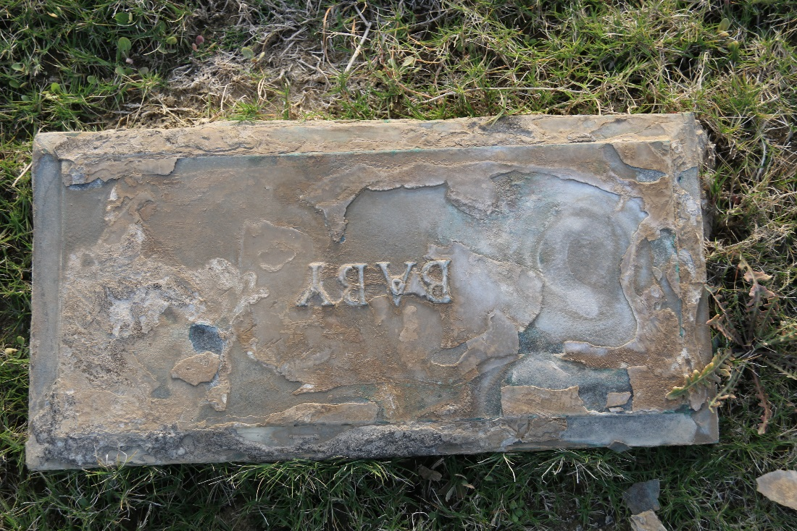
Difficulties – condition of some grave markers

Slide 20
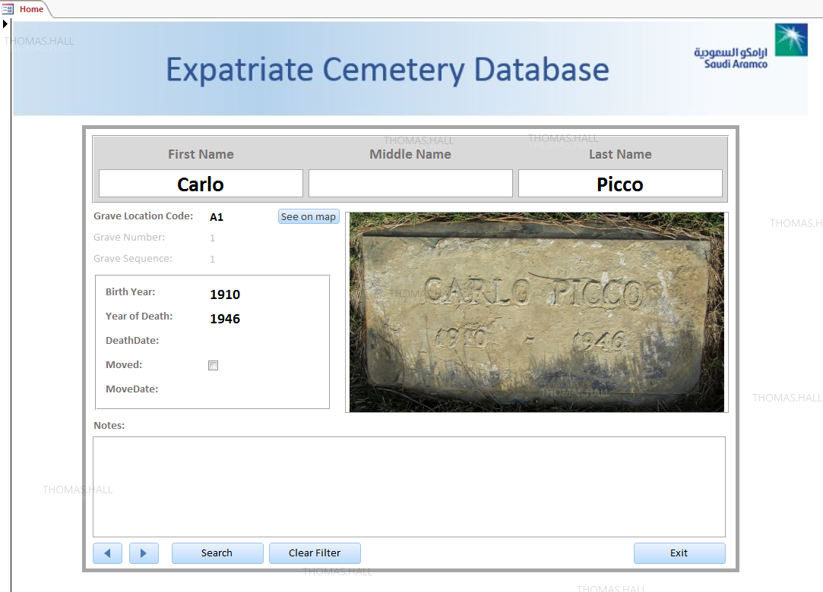
Database – Home screen

Slide 21
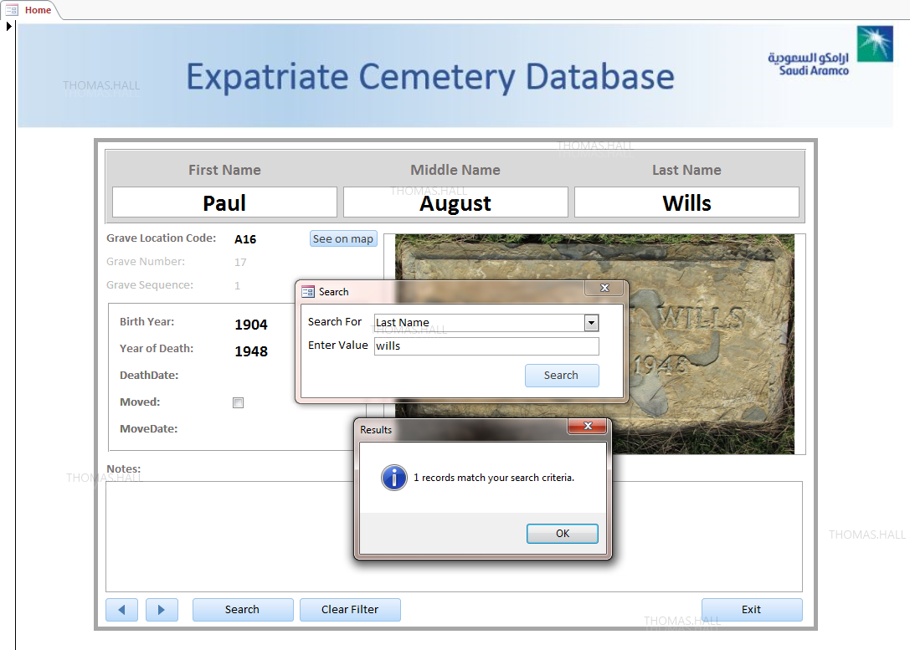
Database – Search & Results

Slide 22
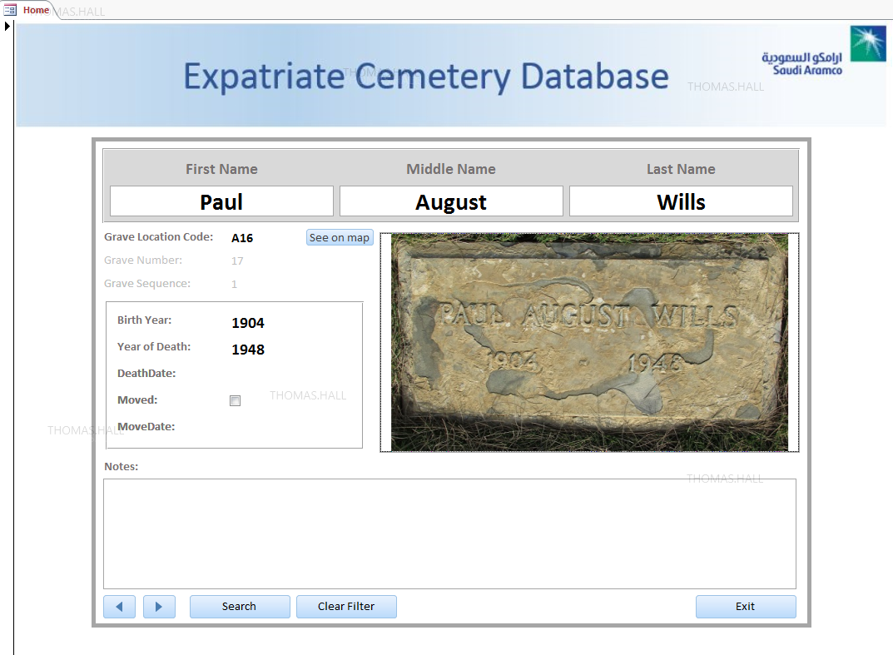
Database – Search & Results

Slide 23
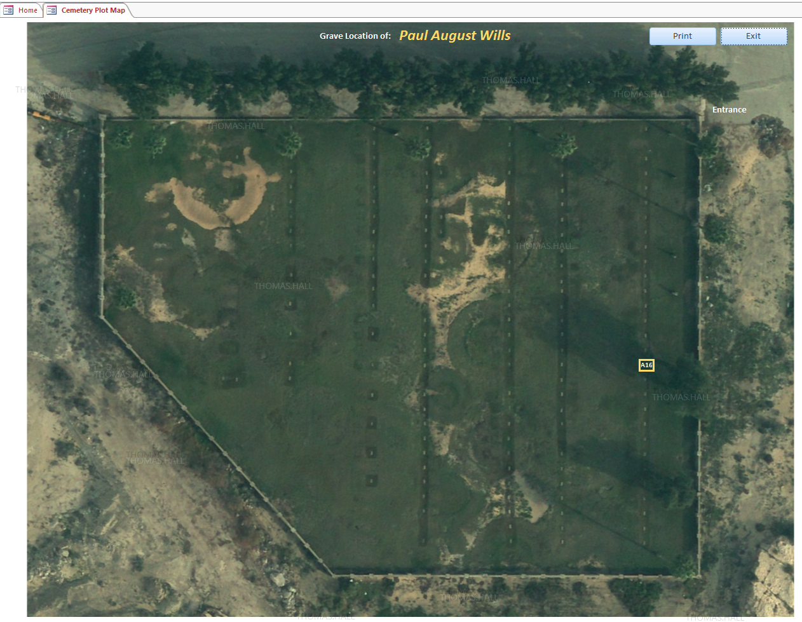
Database – View & Print Location

